Slide 1

UNIT 5
FILE SYSTEM
DISK MANAGEMENT

Slide 2
Magnetic disks

Slide 3
Disk Management
Magnetic disks provide bulk of secondary storage of modern computers
Drives rotate at 60 to 250 times per second
Disk Speed
1.Transfer rate is rate at which data flow between drive and computer
2. Positioning time (random-access time) is time to move disk arm to desired cylinder (seek time) and time for desired sector to rotate under the disk head (rotational latency)
Head crash results from disk head making contact with the disk surface
That’s bad
Disks can be removable
Drive attached to computer via I/O bus
Busses vary, including EIDE, ATA, SATA, USB, Fibre Channel, SCSI, SAS, Firewire
Host controller in computer uses bus to talk to disk controller built into drive or storage array

Slide 4
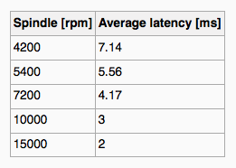
Disk Management
Common Characteristics
Platters range from .85” to 14” (historically)
Commonly 3.5”, 2.5”, and 1.8”
Range from 30GB to 3TB per drive
Performance
Transfer Rate – theoretical – 6 Gb/sec
Effective Transfer Rate – real – 1Gb/sec
Seek time from 3ms to 12ms – 9ms common for desktop drives
Average seek time measured or calculated based on 1/3 of tracks
Latency based on spindle speed
1 / (RPM / 60) = 60 / RPM
Average latency = ½ latency

Slide 5
Disk Management
Access Latency = Average access time = average seek time + average latency
For fastest disk 3ms + 2ms = 5ms
For slow disk 9ms + 5.56ms = 14.56ms
Average I/O time = average access time + (amount to transfer / transfer rate) + controller overhead

Slide 6
Disk Scheduling
OS maintains queue of requests, per disk or device
Idle disk can immediately work on I/O request, busy disk means work must queue
Optimization algorithms only make sense when a queue exists
Note that drive controllers have small buffers and can manage a queue of I/O requests (of varying “depth”)
Several algorithms exist to schedule the servicing of disk I/O requests
The analysis is true for one or many platters
We illustrate scheduling algorithms with a request queue (0-199)
98, 183, 37, 122, 14, 124, 65, 67

Slide 7
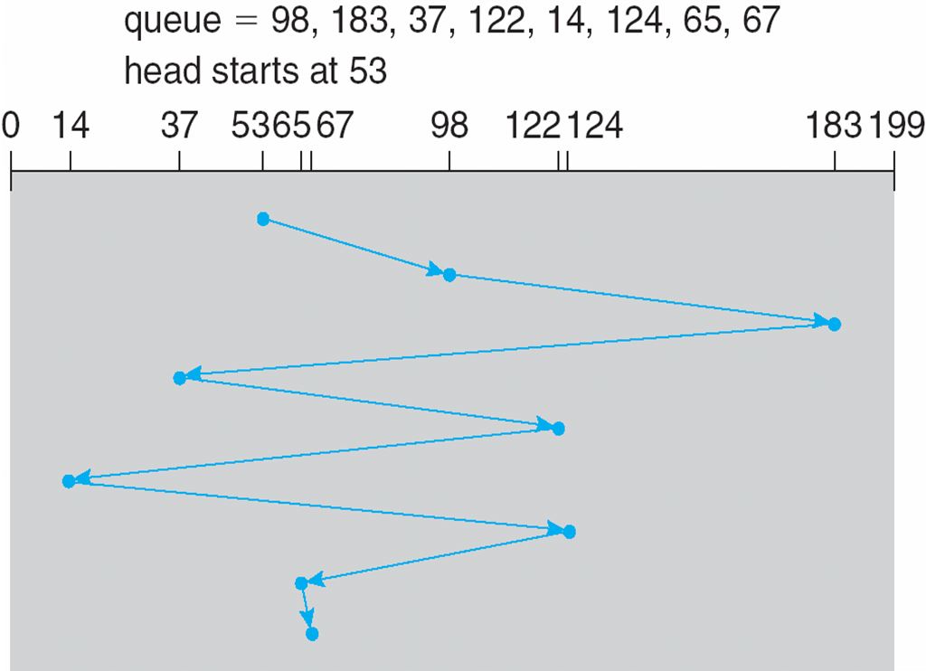
Disk Scheduling - FCFS
Total Head Movements
= (98-53)+(183-98)+(183-37)+(122-37)+(122-14)+(124-14)+(124-65)+(67-65)
=45+85+146+85+108+110+59+2
=640 Cylinders

Slide 8
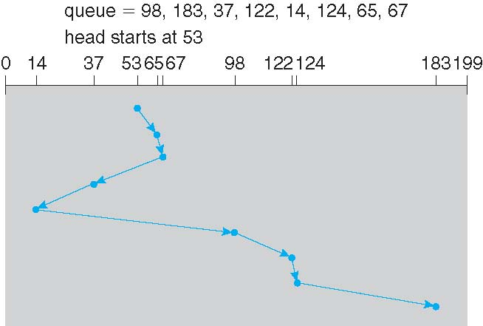
SSTF – Shortest Seek Time First
Total Head Movements
= (65-53)+(67-65)+(67-37)+(37-14)+ (98-14)+ (122-98)+(124-122)+(183-124)
=12+2+30+23+84+24+2+59
=236 Cylinders
Another way to calculate (only calculate end points)
=(67-53)+(67-14)+(183-14)
=14+53+169
=236 cylinders

Slide 9
SCAN
The disk arm starts at one end of the disk, and moves toward the other end, servicing requests until it gets to the other end of the disk, where the head movement is reversed and servicing continues.
SCAN algorithm Sometimes called the elevator algorithm
Illustration shows total head movement of 236 cylinders
But note that if requests are uniformly dense, largest density at other end of disk and those wait the longest

Slide 10
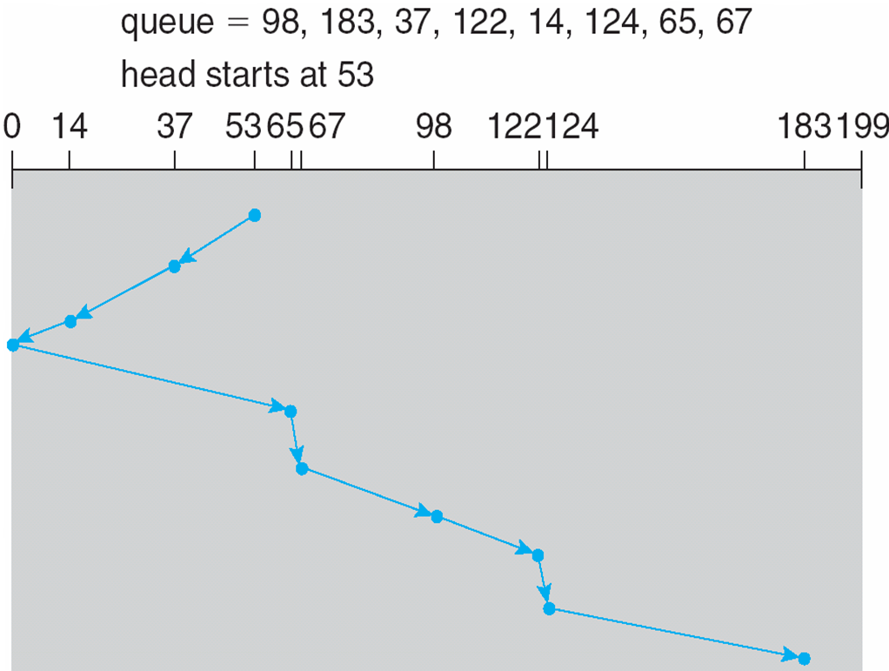
SCAN
Total Head Movements
= (53-0)+(183-0)
=236 Cylinders

Slide 11
C- SCAN
Provides a more uniform wait time than SCAN
The head moves from one end of the disk to the other, servicing requests as it goes
When it reaches the other end, however, it immediately returns to the beginning of the disk, without servicing any requests on the return trip
Treats the cylinders as a circular list that wraps around from the last cylinder to the first one

Slide 12
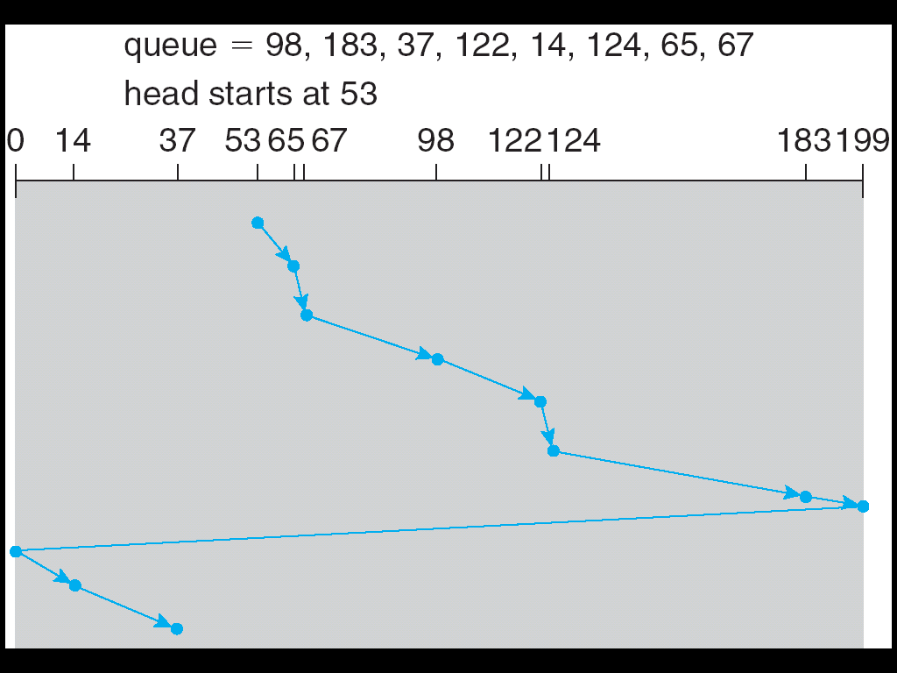
C - SCAN
Total Head Movements
= (199-53)+(199-0)+(37-0)
=382 Cylinders

Slide 13
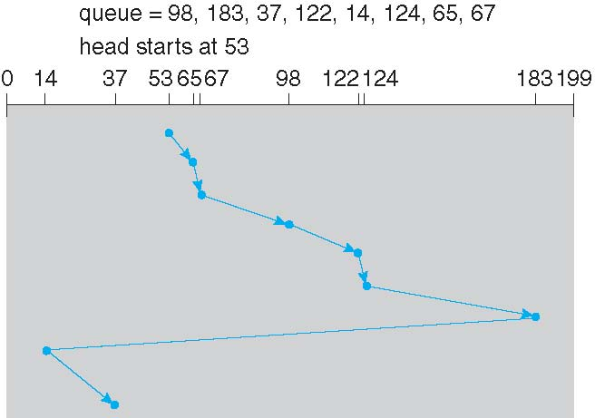
LOOK, C-LOOK
LOOK a version of SCAN, C-LOOK a version of C-SCAN
Arm only goes as far as the last request in each direction, then reverses direction immediately, without first going all the way to the end of the disk
Total Head Movements
= (183-53)+(183-14)+(37-14)
=322 Cylinders

Slide 14


THANK YOU

